Slide 1

A move in the ripe direction
Lea Misigaro

Slide 2
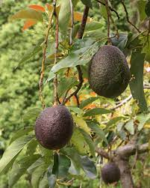
CONTENTS
Preview
Data Collection
Data Wrangling
Exploration
ANOVAs and Independent Chi Square and answering questions
Final Analysis
End

Slide 3
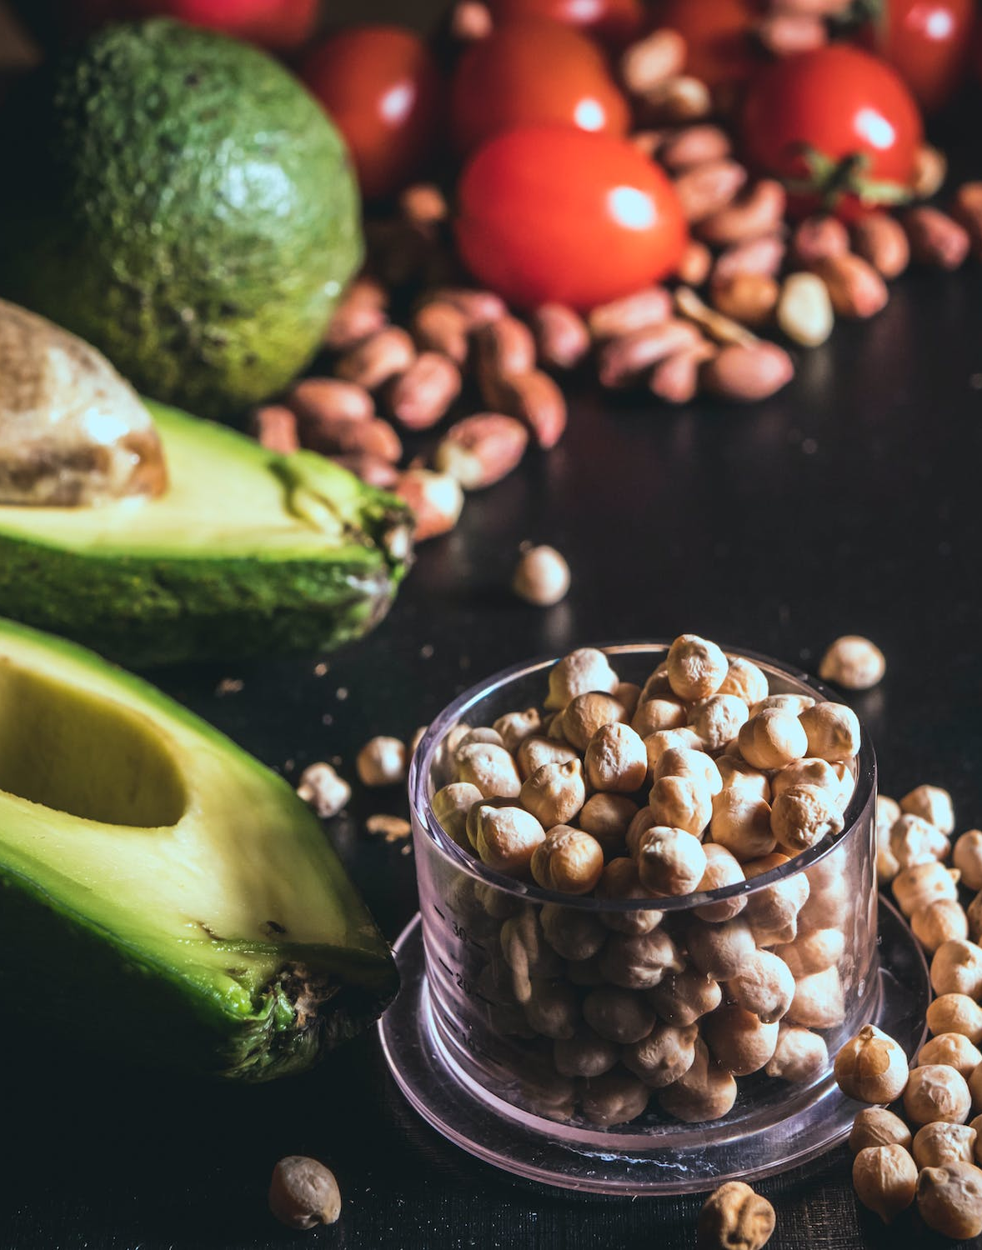
Preview
Warning
Brief Avocado overview
My 4 Qs

Slide 4

Warning:
The following content may contain jokes and puns related to avocados, Hass avocados, and guacamole. Reader discretion is advised. We take no responsibility for any resulting cravings or sudden urges to visit your nearest Mexican restaurant.

Slide 5

The time hass come to learn about Avocado
Researchers believe Puebla, located in South Central Mexico, to be the motherland of the avocado, where this began to be consumed nearly 10,000 years ago. It’s also believed that Mesoamerican tribes first domesticated the avocado tree (Persea Americana) 5,000 years ago, making the cultivation of avocados as old as the invention of the wheel.
Prior to its domestication, it’s thought the survival of the avocado may have been dependent on the ability of since-extinct large mammals to stomach the fruit’s mildly toxic pit after swallowing the large berry whole. In theory, the seed was ready to sprout by the time it was excreted.

Slide 6
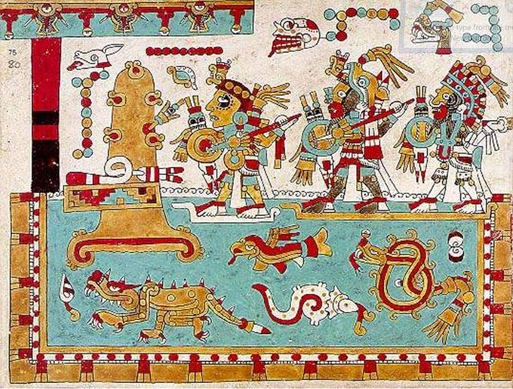

So thank you meso americans & giant ground sloths
This Photo by Unknown Author is licensed under CC BY-SA
This Photo by Unknown Author is licensed under CC BY-SA-NC

Slide 7
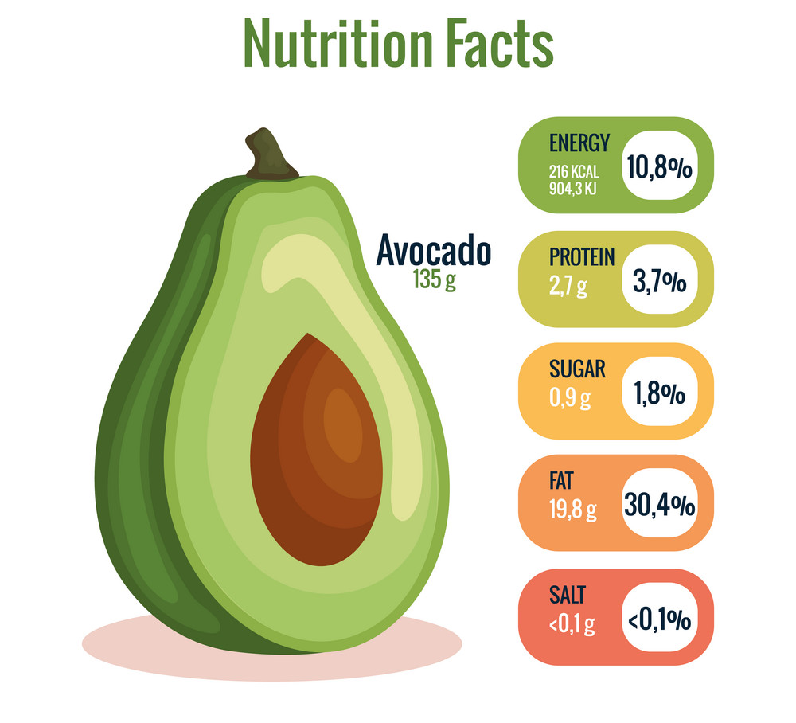
avocado has several potential health benefits
Nutrient-rich: Avocados are packed with nutrients such as fiber, healthy fats, potassium, vitamin K, vitamin E, vitamin C, and vitamin B6.
Heart-healthy: The monounsaturated fats in avocados can help lower LDL (bad) cholesterol and reduce the risk of heart disease.
Promotes healthy digestion: The high fiber content of avocados can aid in digestion and promote regular bowel movements.
May help with weight management: The healthy fats and fiber in avocados can help you feel full and satisfied, which may prevent overeating and aid in weight loss.
Supports healthy skin: The vitamin C and vitamin E in avocados have antioxidant properties that can help protect your skin from damage caused by free radicals.
May help prevent certain diseases: Some studies suggest that avocados may have anti-inflammatory properties and may help reduce the risk of certain diseases such as cancer, arthritis, and diabetes.

Slide 8
My 4 Qs
1: How do the 3 Cities volume of Avocado consumption compare to each other? (ANOVA will be used)
2: How do the 3 Cities Average Price of Avocados compare to each other? (ANOVA will be used)
3: How do different regions compare to each other in Avocado consumptions using the total bags sold (ANOVA will be used)
4: Does elevation play a part in Avocado consumptions using the total bags sold (Independent Chi square will be used)

Slide 9

Data Collection
Downloaded from the Woz-U Github repo
CSV file
Original source is from Kaggle
USGS.Gov

Slide 10
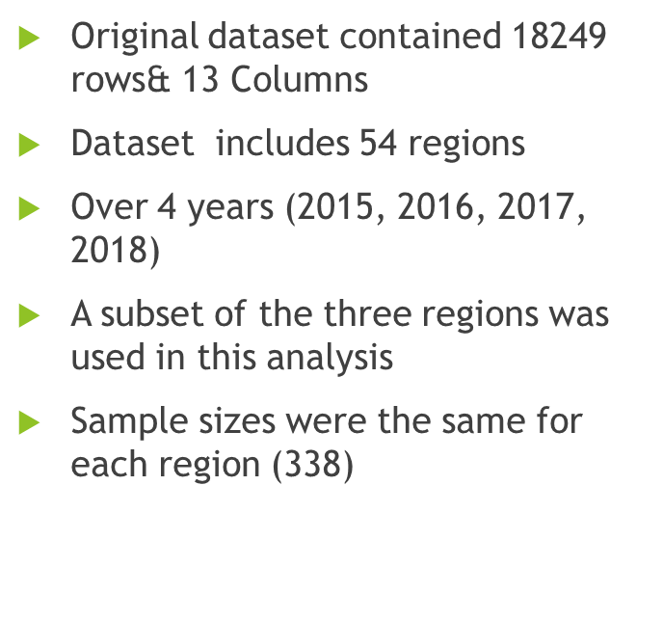
Data Wrangling

Slide 11
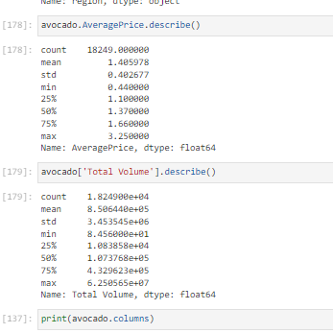
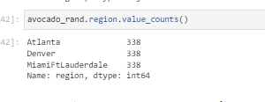
Data Wrangling for Q 1&2

Slide 12
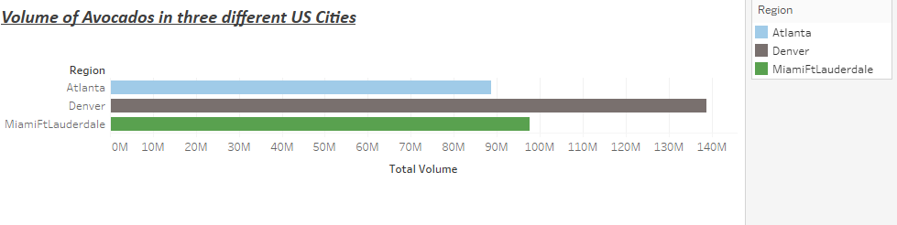

Slide 13
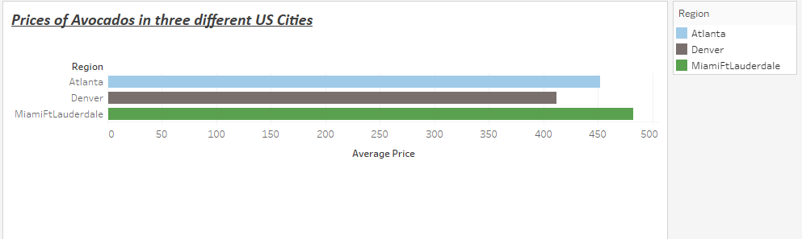
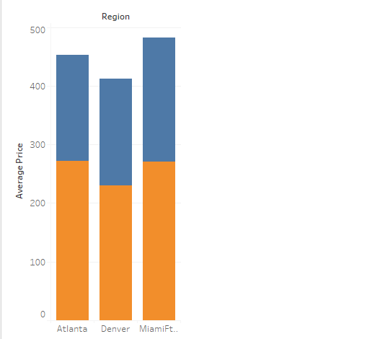

Slide 14
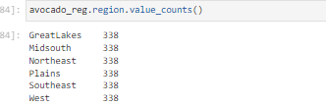
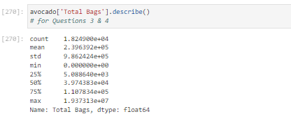
Data Wrangling for Q 3
Original dataset contained 18249 rows& 13 Columns
Dataset includes 54 regions
Over 4 years (2015, 2016, 2017, 2018)
A subset of the three regions was used in this analysis
Sample sizes were the same for each region (338)

Slide 15
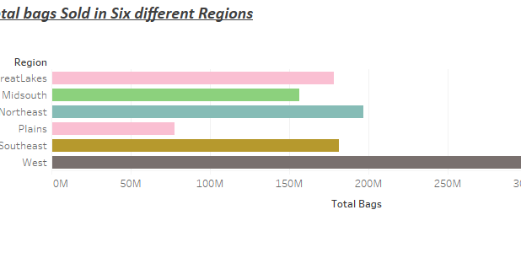

Slide 16
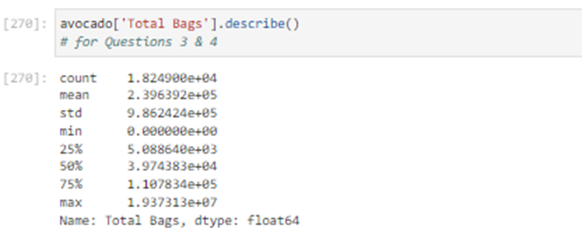
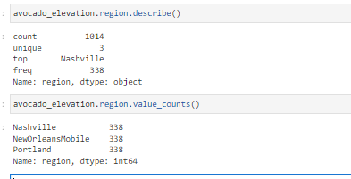
Data Wrangling for Q 4

Slide 17
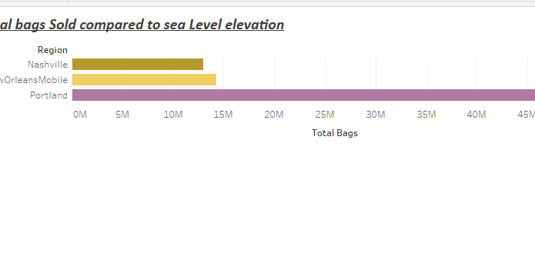

Slide 18
1: How do the 3 Cities volume of Avocado consumption compare to each other?
We will be using ANOVA Assumption of Normality

Slide 19
What did the avocado say to the toast?
“You complete me!”

Slide 20
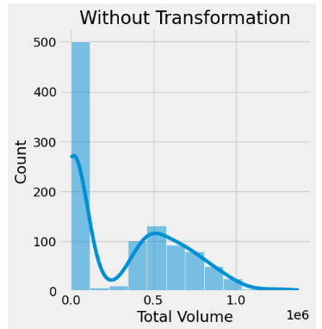
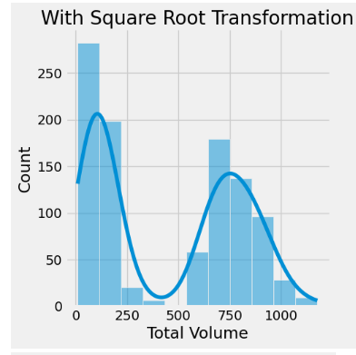
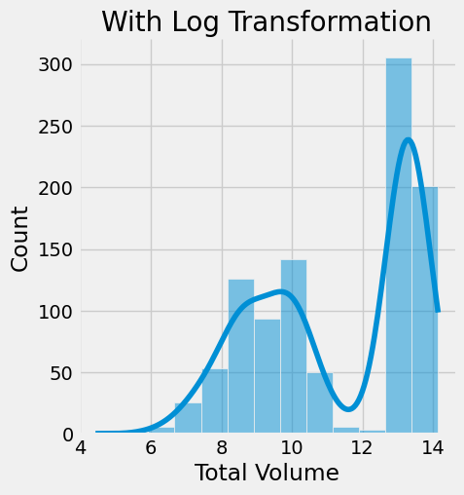
ANOVA

Slide 21
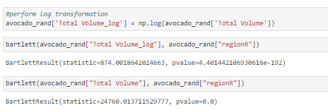
-Sample size has a least 20 cases per independent variable -No overlap between groups (regions) and region testings are not related -Sphericity is not applicable because it’s not a between subjects design
The first test indicates a highly significant difference in the variances between the Total Volume and the 3 random cities chosen.
The second test is performing a Bartlett test without transforming. The result shows a highly significant difference in variances between Total Volume and the 3 random cities chosen.
In both cases, the null hypothesis is that the variances of the two variables are equal. A significant result indicates that the variances are not equal.

Slide 22
Contin.
violating the assumption of homogeneity of variances is not ideal but can still move ahead with the analysis since we know that each city doesn't impact the other cities chosen.

Slide 23
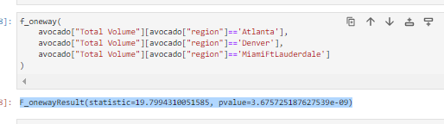
F_onewayResult
the output suggests that there is a significant difference between the means of Total Volume and the 3 random cities chosen.

Slide 24
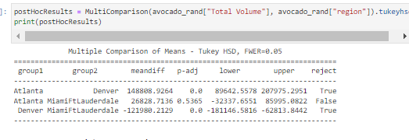
Post-Hoc
this indicates that there are significant differences in mean values between Denver and the other two groups, while Atlanta and MiamiFtLauderdale do not differ significantly from each other.

Slide 25
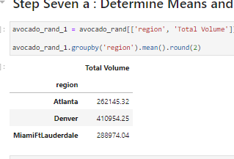
In other words, Atlanta and Denver have significantly different total volume, as well as MiamiFtLauderdale, but Atlanta and MiamiFtLauderdale do not have significantly different total volume.

Slide 26
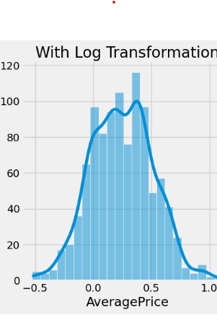
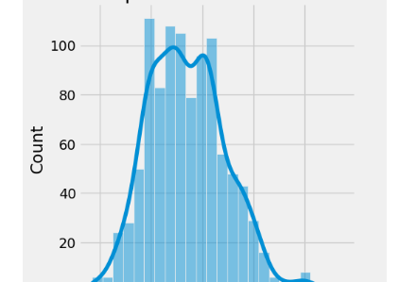
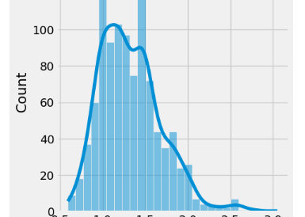
(2) How do the 3 Cities Average Price of Avocados compare to each other?

Slide 27
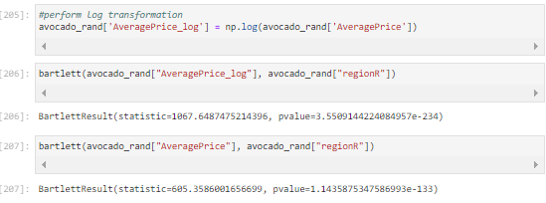
Barlett Test
p-value less than0.05 indicates that for both tests the null hypothesis can be rejected, and there is evidence for the alternative hypothesis.

Slide 28
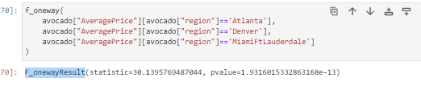
F_onewayResult
onewayResult
The p-value <0.05), so we reject the null hypothesis

Slide 29
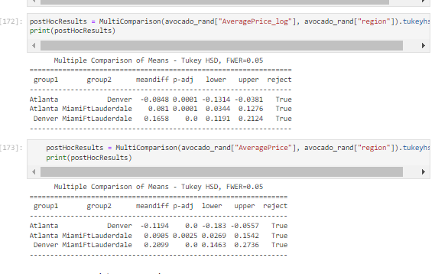
Post-Hoc
The first set of results shows the pairwise comparisons between the three regions (Atlanta, Denver, and MiamiFtLauderdale) for the log-transformed average price of avocados. The Tukey HSD test is used to compare all pairs of means and identify if there is a significant difference between them.
The results show that there are significant differences between all pairs of means at a significance level of 0.05, as indicated by the "reject" column. The mean log-transformed price in Denver is significantly lower than in Atlanta and MiamiFtLauderdale, while the mean log-transformed price in MiamiFtLauderdale is significantly higher than in Atlanta and Denver.
The second set shows the pairwise comparisons between the same three regions, but this time for thr(raw) average price of avocados. The Tukey HSD test also used agian
The results show that there are also significant differences between all pairs of means at a significance level of 0.05. The mean price in Denver the lowest ,while the mean price in MiamiFtLauderdale is the highest among the three
Overall, both sets of results suggest that there are significant differences in average avocado prices across the three regions.

Slide 30
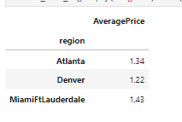

Slide 31

Fun Fact!!
Avocado was called the Alligator pear in the 1900 due to it’s rough outer skin

Slide 32
3: How do different regions compare to each other in Avocado consumptions using the total bags sold
We will be using ANOVA Assumption of Normality

Slide 33
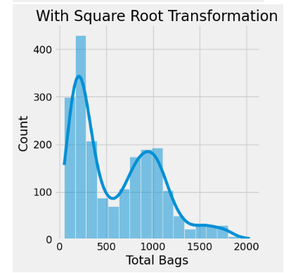
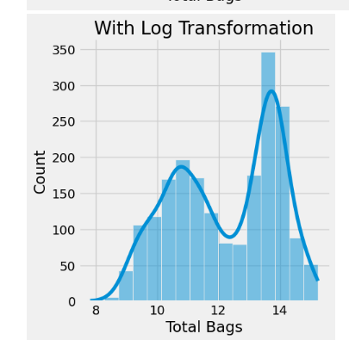
Closest to “Normal”

Slide 34
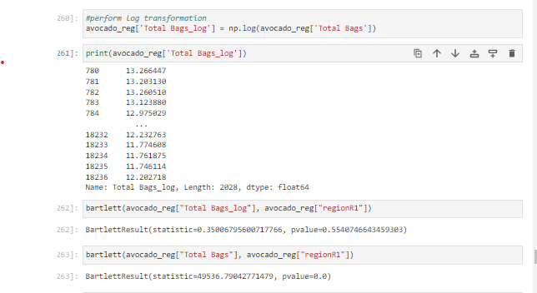
Barlett Test
. In the first finding had a p-value of 0.55, so there is no difference in variances among the different regions.
In contrast, the second one had a p-value of 0. This suggests that there is a significant difference in variances among the different regions.
Overall, these results suggest that transforming the data, by taking the log can sometimes be useful in making variances more balanced across different groups, which can lead to better stat tests.

Slide 35
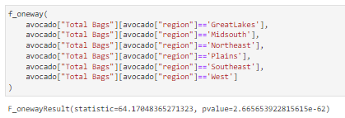
F_onewayResult
test and shows that there is a significant difference between the means of at least two Regions in the data
the p-value is tiny , it is against the null hypothesis that the means are equal.
So, we can conclude that there is a significant difference between the Regions in the data.

Slide 36
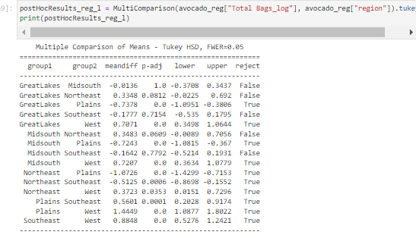
Post-Hoc
The results show the comparison of the mean differences between the log-transformed "Total Bags" variable and "region" categories using the Tukey HSD test.
The reject column indicates which group comparisons reject the null hypothesis of equal means based on a 0.05 family-wise error rate (FWER) control.
So, it further proves that there are significant differences in mean "Total Bags" between several "region" categories, including GreatLakes-Plains, GreatLakes-West, Midsouth-Plains, Midsouth-West, Northeast-Plains, Northeast-Southeast, Northeast-West, Plains-Southeast, Plains-West, and Southeast-West.

Slide 37
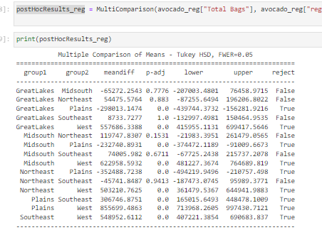
Post-Hoc Contin..
From the results, it appears that there are significant differences in "Total Bags" between regions
That is, except for the comparisons involving the Great Lakes and Midsouth, Great Lakes and Northeast, and Great Lakes and Southeast regions.

Slide 38
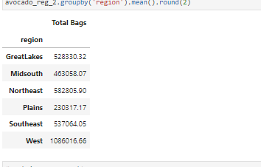

Slide 39
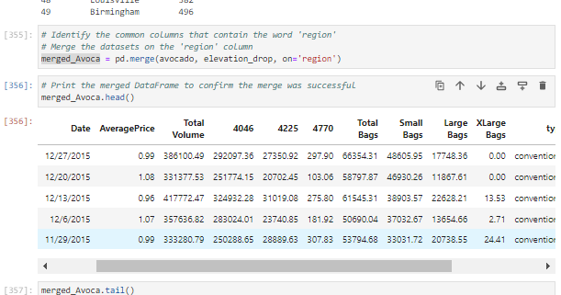

Slide 40
I’m just here to avo good time. Cause Hass Queen we are almost done

Slide 41
4: Does elevation play a part in Avocado consumptions using the total bags sold
Independent Chi Squar

Slide 42
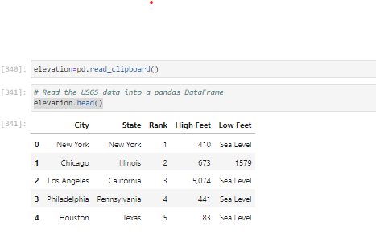
It hass dawned on me that not only is sea level elevation data I found was conducted and gathered from the 1980 Census.
Get URL data into my Notebook to combine
I also found out "Sea level is determined by measurements taken over a 19-year cycle. increase in the average reach of the ocean. The current sea level rise is 1.8 millimeters (. 07 inch) per year."
43 times .07 inch for each year is 3.01in diffrence, which would still keep me okay enough to keep my 3 planed cities

Slide 43
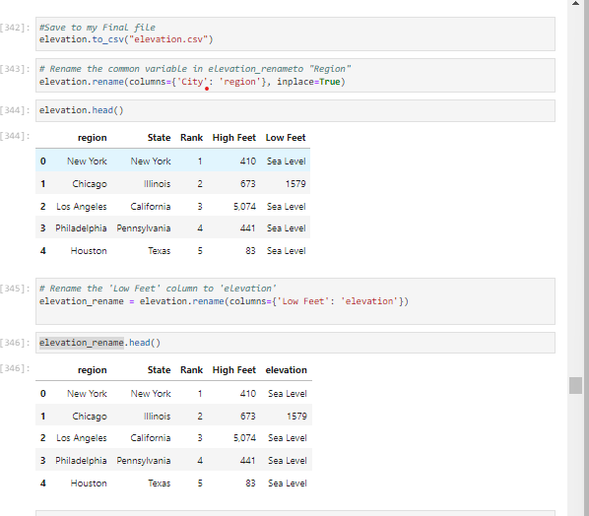

Slide 44
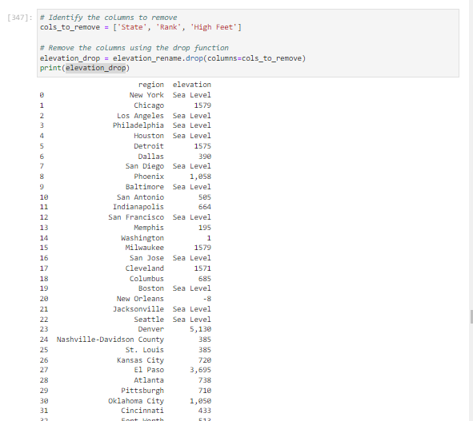
Contin.

Slide 45
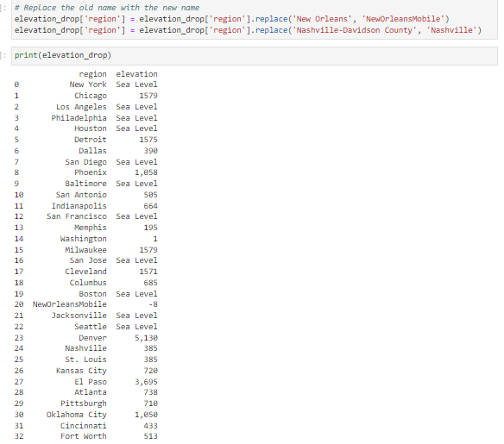

Slide 46
Independent Chi square
Test for assumptions
-Check for independence
-Check for sample size
-Check for expected cell count
-Check the level of measurement

Slide 47
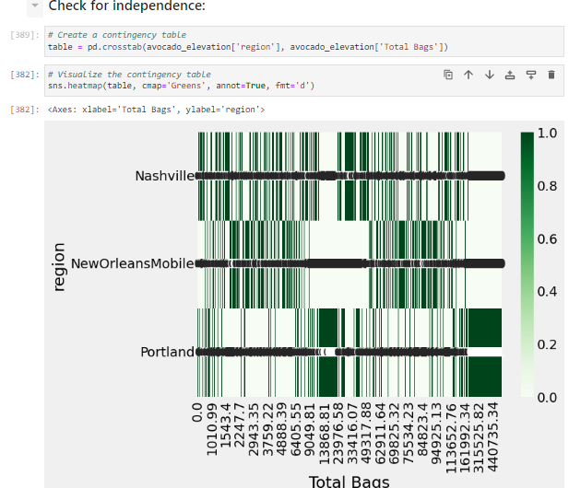
p-value of 0.483 suggests that there is not enough evidence to reject the null hypothesis and there is no significant association between 2 variables being tested
See next

Slide 48


Slide 49
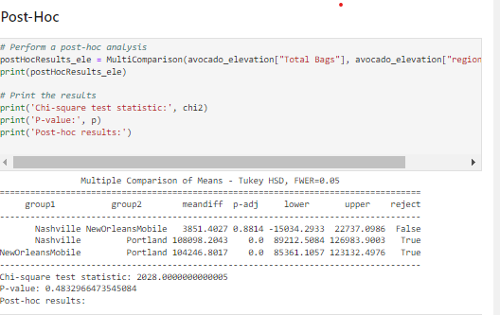
Post-Hoc
The results show that the mean difference between Nashville and NewOrleansMobile is not significant, but both Nashville and NewOrleansMobile have significantly different means when compared to Portland.
The chi-square test statistic and p-value are not relevant to the Tukey HSD test.

Slide 50
Final Analysis
After conducting the code to test out my hypothesis, I noticed something interest that didn’t occur to me at first
Western states and regions always had a more likely chance of selling and consuming avocados
I also noticed that when it came to my elevation question, it would have been better to get the 3 types of elevation in the same region.and then done the comparison
Densely populated area tended to have more avocado consumption verses rural areas, like the plains.
Overall, this proved some thing I already knew and left me wondering If I should ask more specific questions

Slide 51
Bravocado! We have made it

